Slide 1
Loading Large datasets in MySQL
Loading large datasets with table data import wizard takes lot of time
Create the table using SQL query create table along with column types
Make C drive show hidden folders. Required to access Program Data Folder
Paste the CSV File in “C:\ProgramData\MySQL\MySQL Server 8.0\Uploads”
Write load data infile query

Slide 2
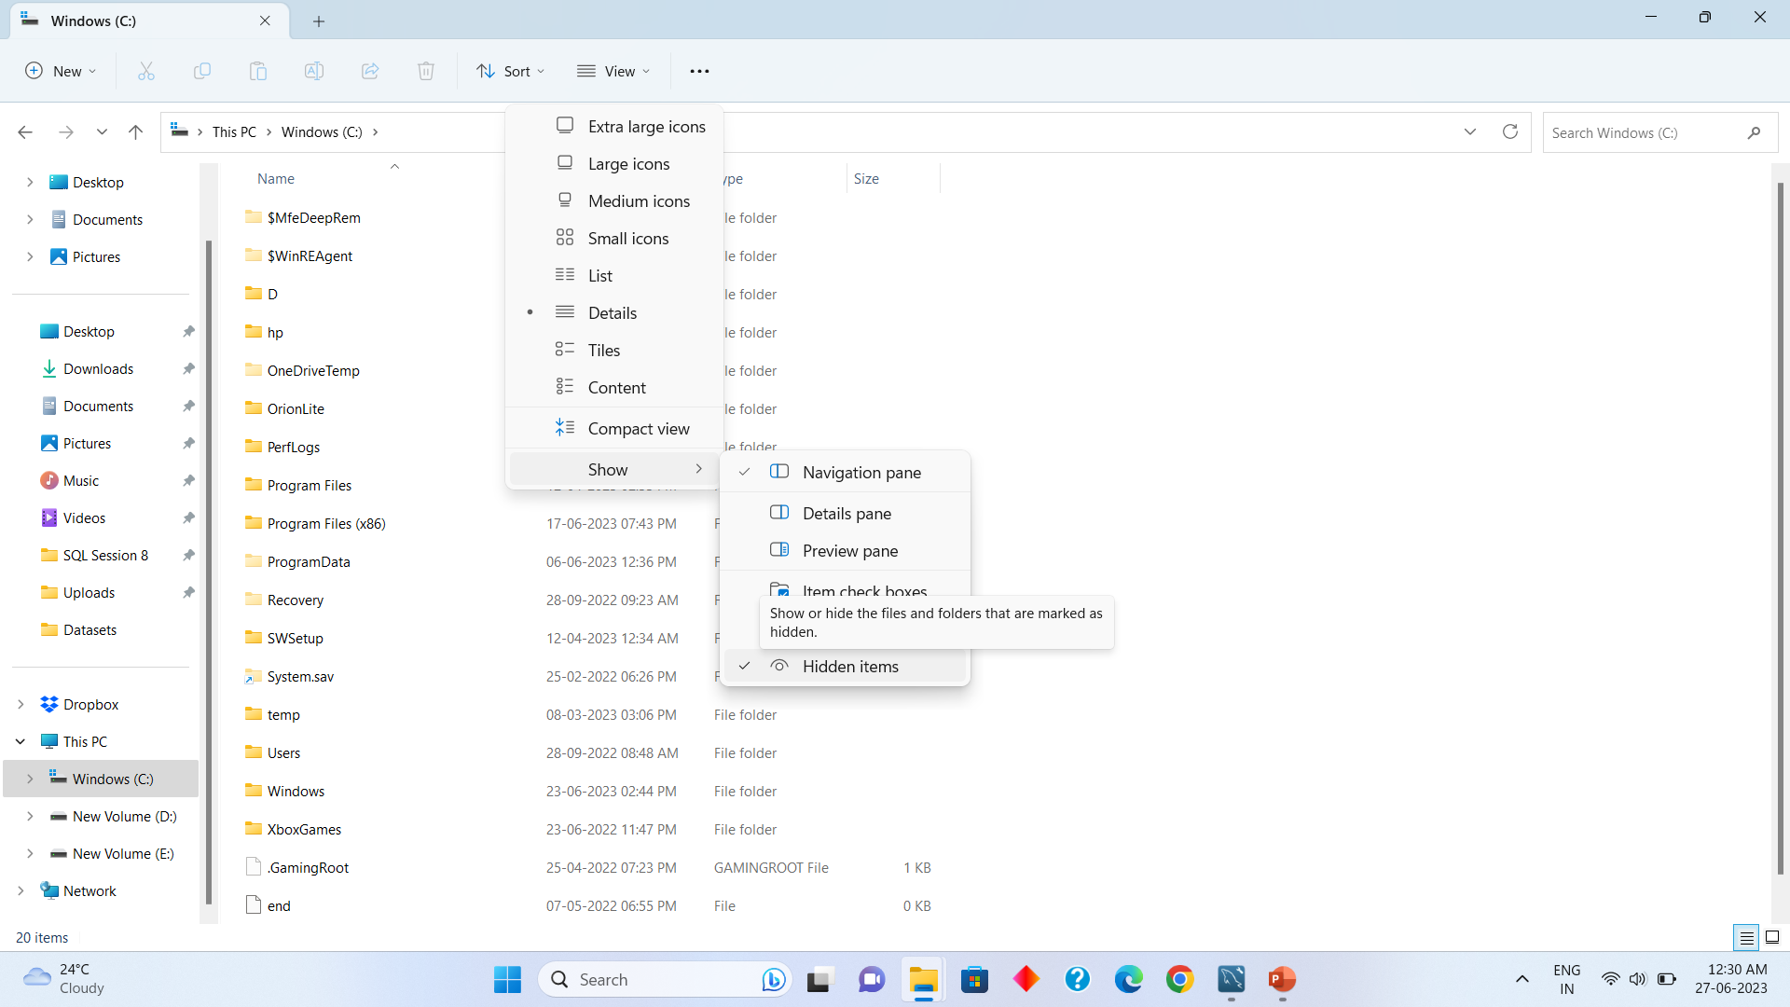
Showing hidden items in C Drive windows 11

Slide 3
Load Data Infile query
Note that you need to create the table inside MySQL first with CREATE TABLE Query
load data infile 'Athletes_Transformed.csv’
into table athletes1
fields terminated by ',’
enclosed by '“’
lines terminated by '\r\n’
ignore 1 rows;
Query if path not matching
SHOW VARIABLES LIKE "secure_file_priv";

Slide 4
create table Olympics
(ID int,Name
varchar(400) ,
Sex varchar(50) ,
Age int,
Height int,
Weight int ,
Team varchar(300),
NOC varchar(300),
Games varchar(200),
Year int,
Season varchar(200),
City varchar(100),
Sport varchar (100),
Event varchar (100),
Medal varchar(100));

Slide 5
SHOW VARIABLES LIKE "secure_file_priv";

Slide 6
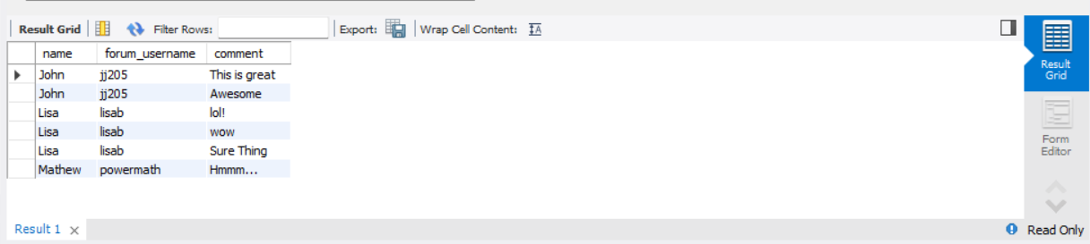
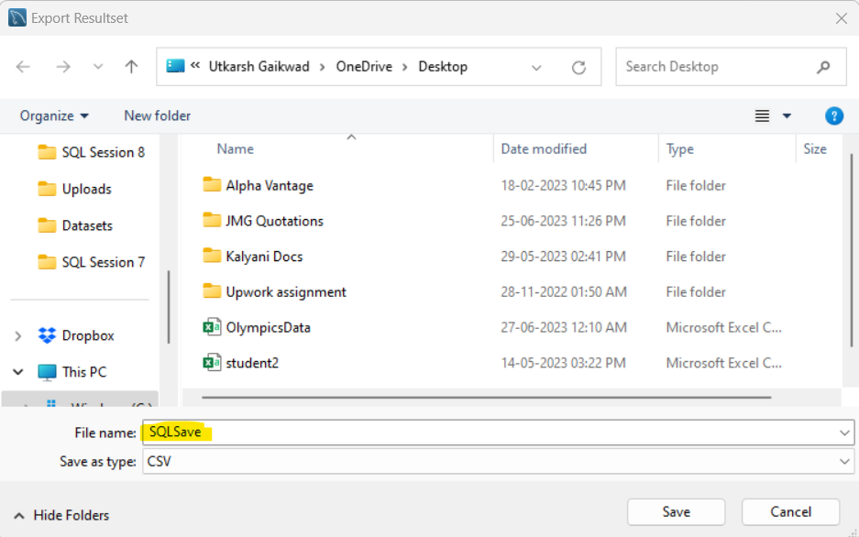
Exporting SQL Results to CSV File

